Slide 1

Customer Shopping Behavior Analysis
Analyzing 3,900 purchases to uncover insights into spending patterns, customer segments, and product preferences that drive strategic business decisions.

Slide 2
Dataset Overview
3,900
18
50
25
Total Purchases
Data Columns
Locations
Products
Transactions analyzed across all categories
Comprehensive customer and purchase attributes
Geographic distribution of customers
Unique items across four categories
Customer Demographics
Shopping Behavior
Age, gender, location, and subscription status tracked for behavioral insights.
Discounts, promo codes, purchase frequency, ratings, and shipping preferences analyzed.

Slide 3

Data Preparation & Cleaning
01
02
Data Loading & Exploration
Missing Data Handling
Imported dataset using pandas, examined structure with df.info() and summary statistics.
Imputed 37 missing Review Rating values using median rating per product category.
03
04
Feature Engineering
Database Integration
Created age_group bins and purchase_frequency_days columns for deeper analysis.
Connected to PostgreSQL and loaded cleaned data for SQL business analysis.

Slide 4
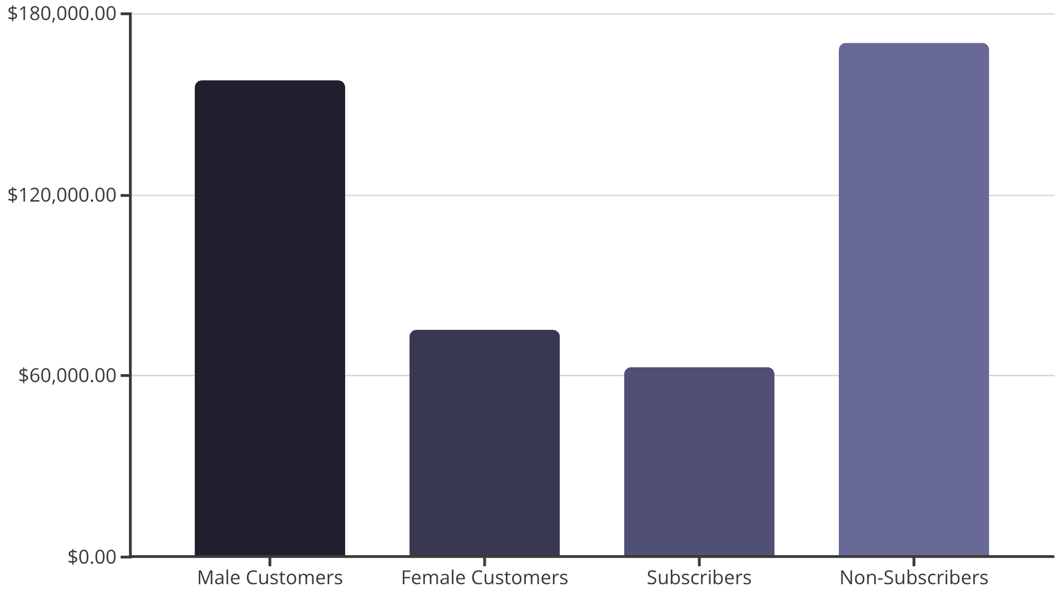
Revenue Insights
Key Findings
Male customers generate 2.1x more revenue than female customers. Non-subscribers contribute significantly more total revenue despite similar average spend per customer.

Slide 5
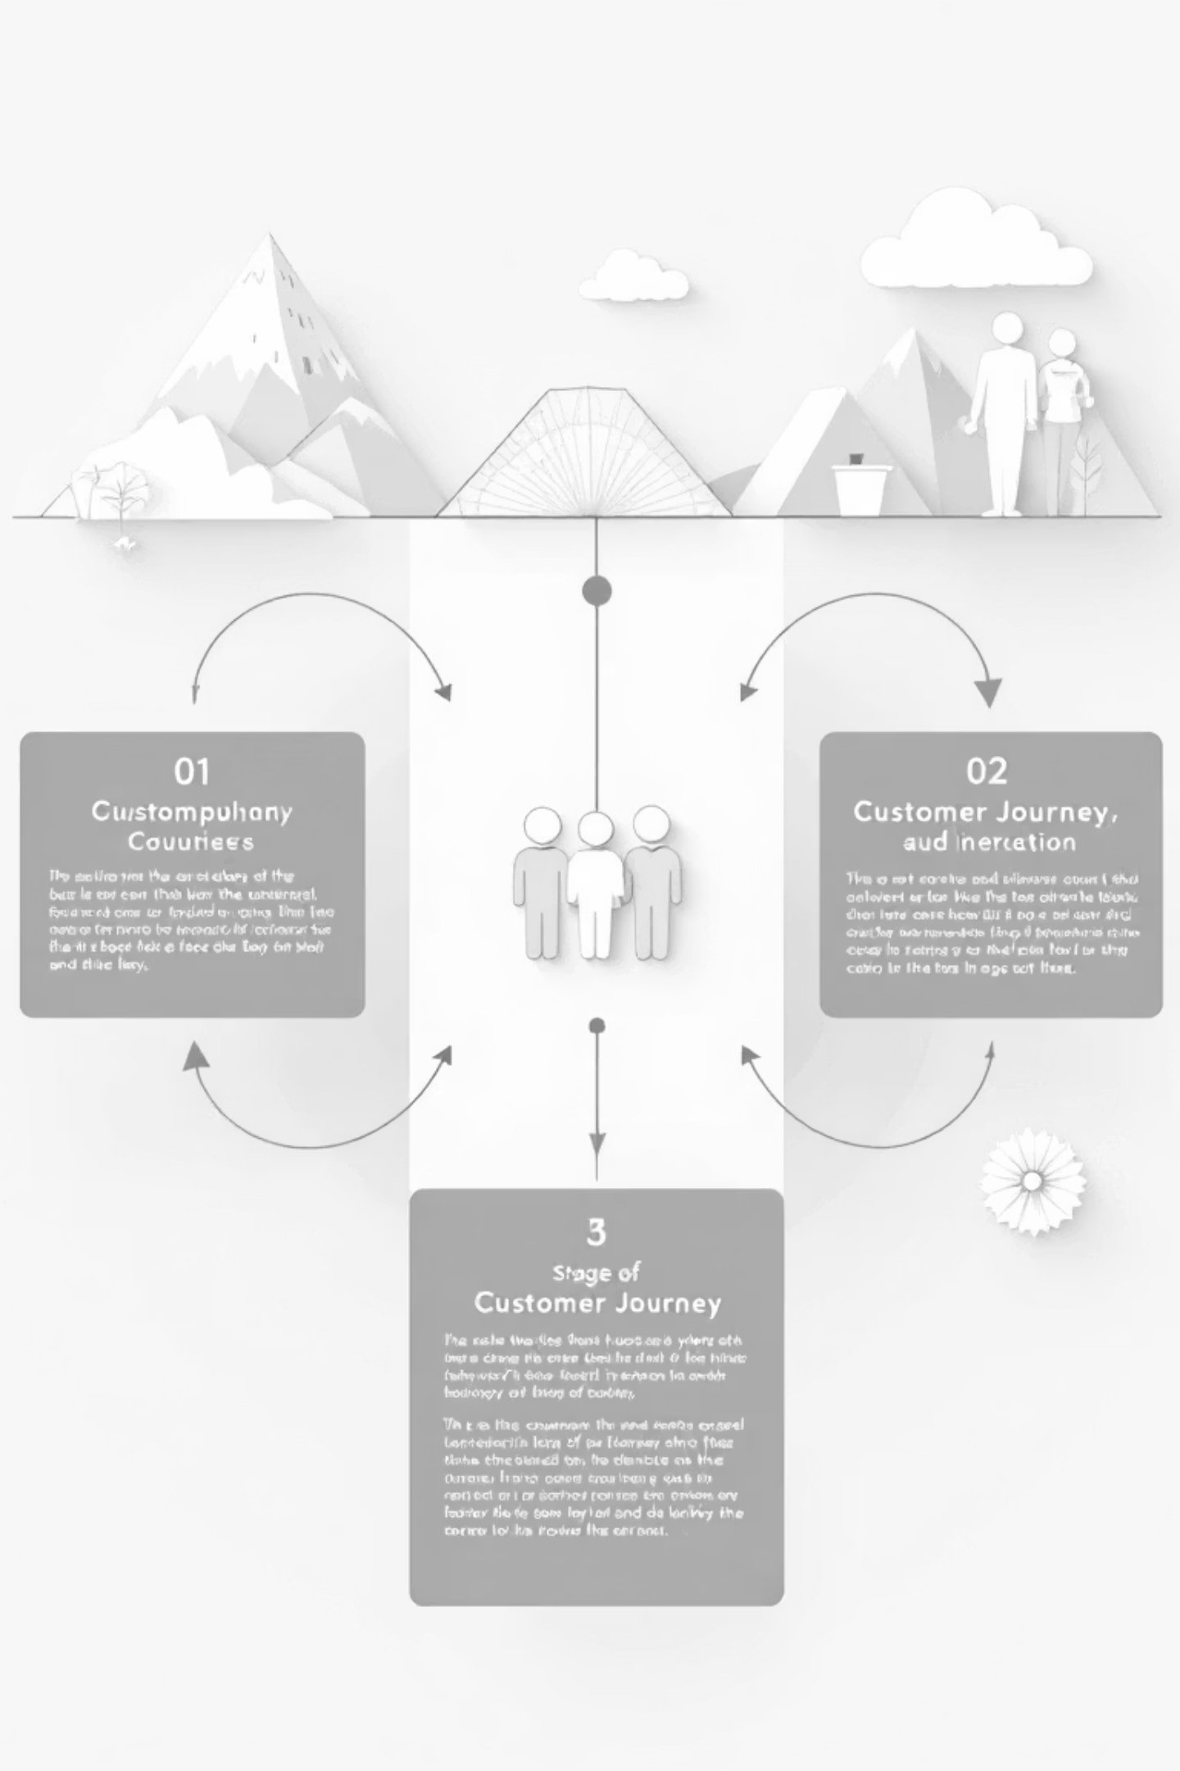
Customer Segmentation
Loyal Customers
Returning Customers
3,116 customers
701 customers
Highest value segment with consistent purchase history and engagement.
Growing segment showing repeat purchase behavior and potential for loyalty.
New Customers
83 customers
Fresh acquisition opportunities requiring nurturing and engagement strategies.

Slide 6
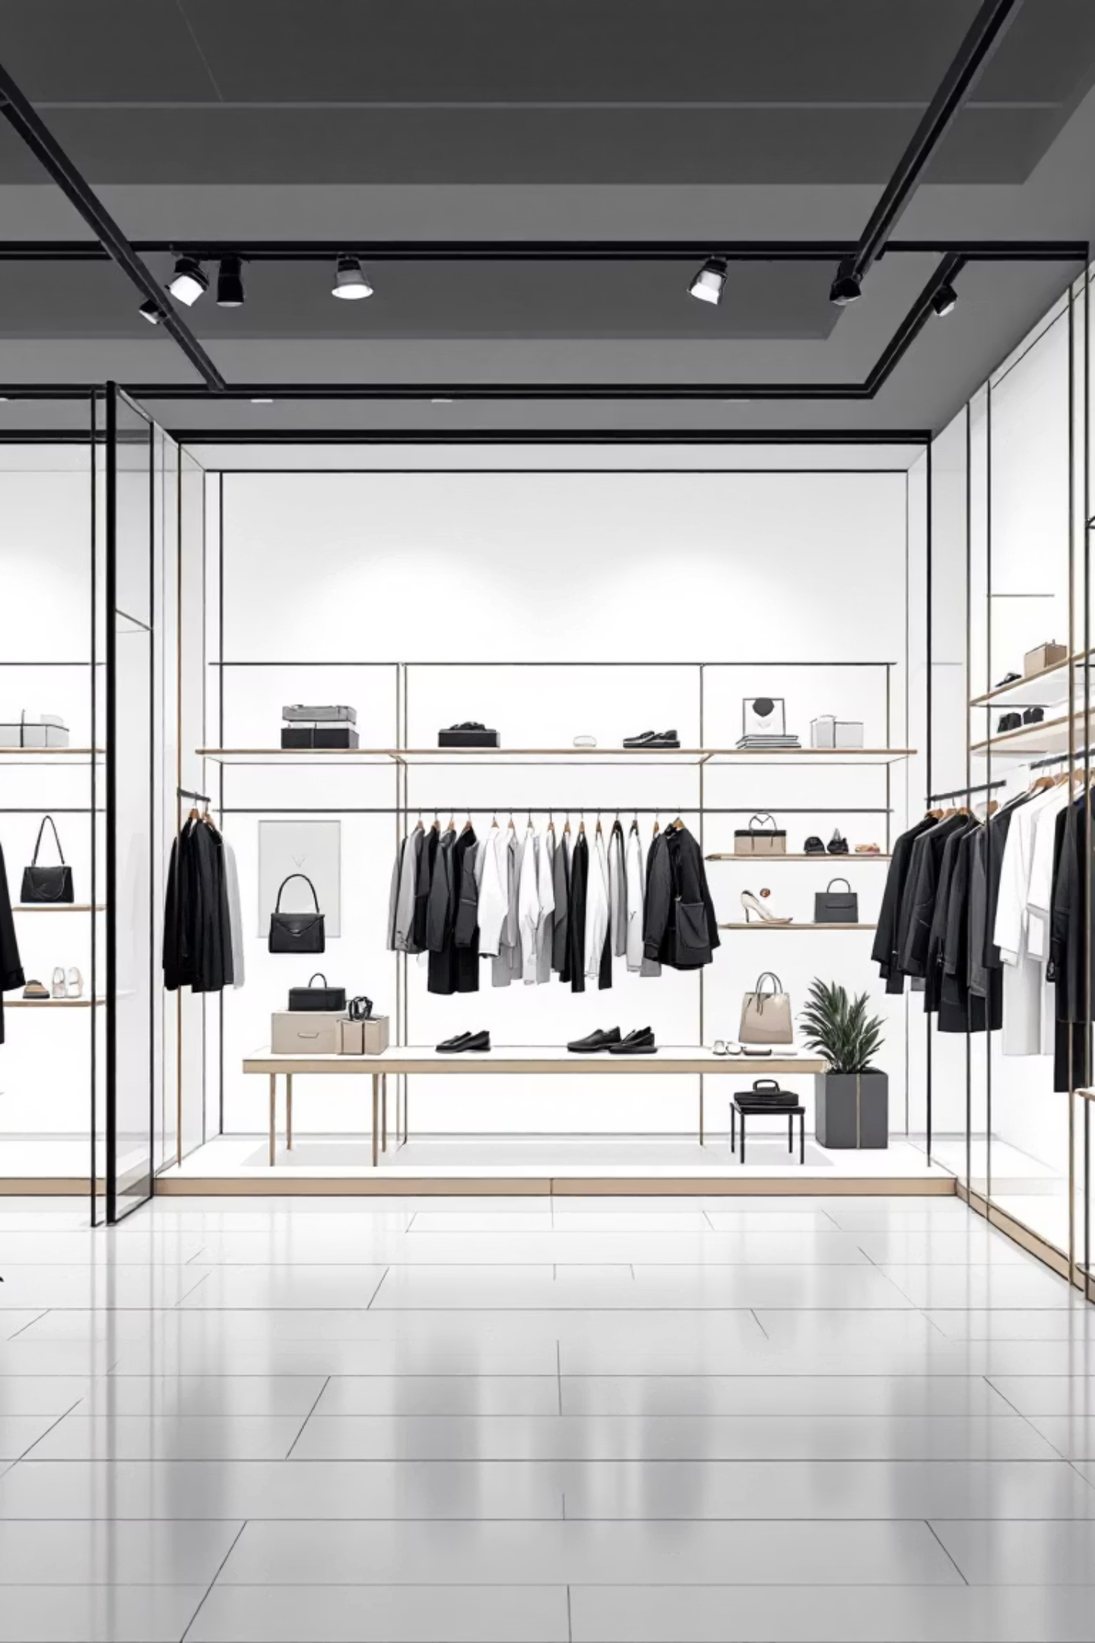
Top Performing Products
Highest Rated Items
Best Sellers by Category
Gloves - 3.86 rating
Accessories: Jewelry (171 orders)
Sandals - 3.84 rating
Boots - 3.82 rating
Clothing: Blouse & Pants (171 orders each)
Hat - 3.80 rating
Skirt - 3.78 rating
Footwear: Sandals (160 orders)
Outerwear: Jacket (163 orders)

Slide 7
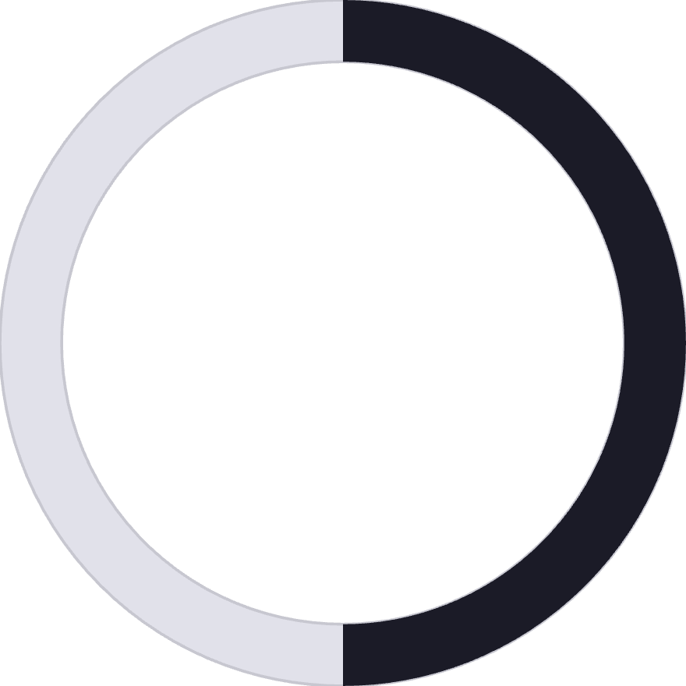
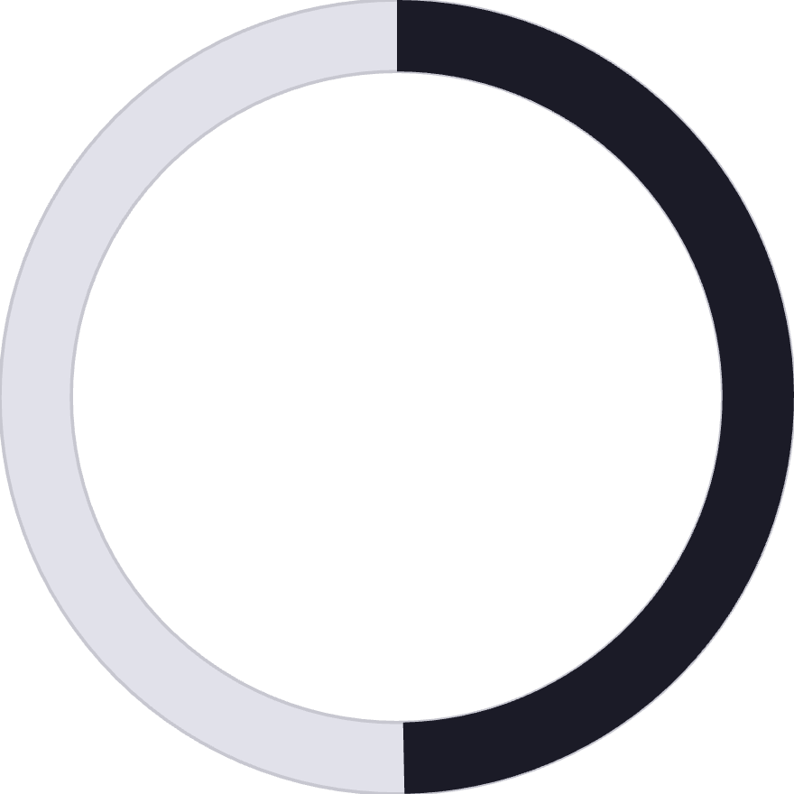
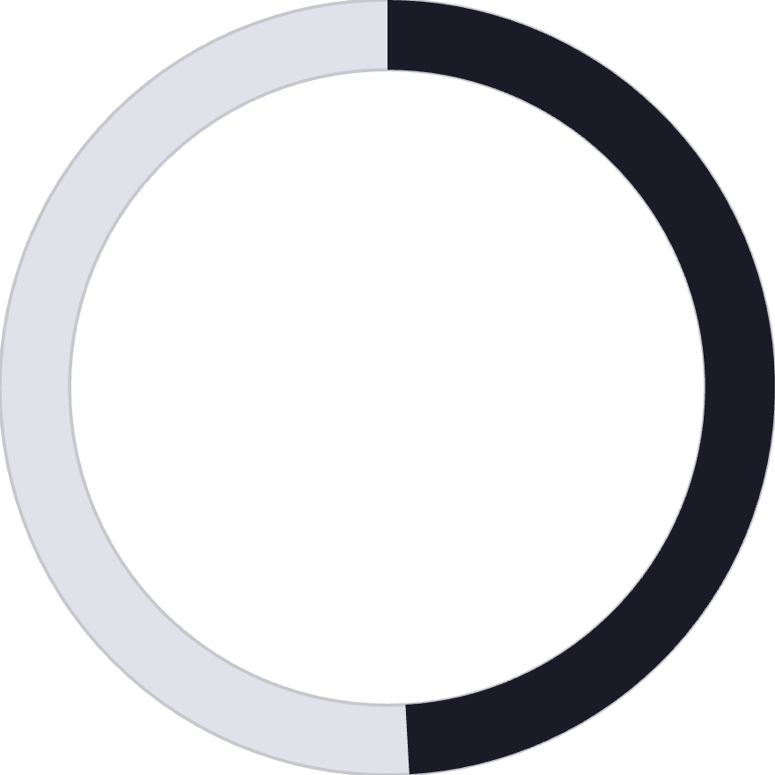
Discount & Pricing Analysis
50%
49.7%
49.1%
Hat Discount Rate
Sneakers
Coat
Highest percentage of discounted purchases
Second most discounted product
High discount dependency
839 customers used discounts but still spent above average ($59.76), indicating price-conscious yet high-value shoppers. Express shipping users spend $2 more on average than standard shipping customers.

Slide 8
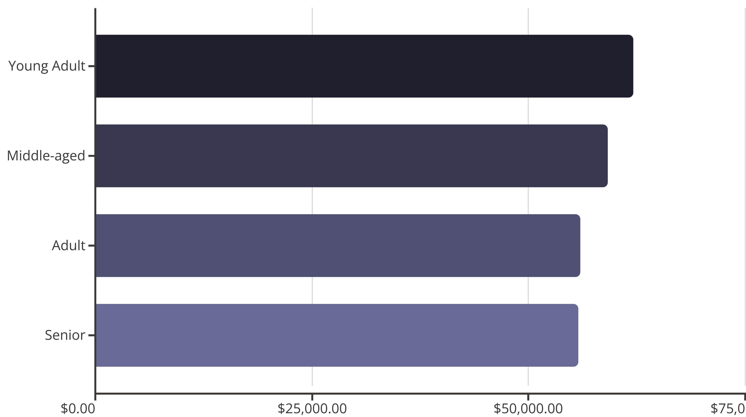
Age Group Revenue Distribution
Young adults lead revenue generation, followed closely by middle-aged customers. Relatively balanced distribution suggests broad market appeal across age demographics.

Slide 9

Interactive Dashboard
Comprehensive Power BI dashboard visualizes key metrics including revenue trends, customer segmentation, product performance, and behavioral patterns for real-time business intelligence.

Slide 10
Strategic Recommendations
Boost Subscriptions
Customer Loyalty Programs
Promote exclusive benefits to convert the 2,847 non-subscribers. Target repeat buyers with >5 purchases who show loyalty potential.
Reward the 701 returning customers to accelerate their transition into the loyal segment of 3,116 customers.
Review Discount Policy
Targeted Marketing
Balance promotional sales with margin control. Focus discounts on high-rated products like gloves and sandals to maximize impact.
Focus campaigns on young adults and express-shipping users. Highlight top-rated products in category-specific promotions.

